Slide 1
CSS342 Data Structures, Algorithms, and Discrete Mathematics (I)

Slide 2
Quiz 1
20 minutes

Slide 3
Goals by the end of this week (10/8, 10/10)
Join Disco (last call)
Get comfortable with write C++, Makefile
Get familiar with CMake
OOP design
Better Code/Testing Quality
Textbook “Data Abstraction & Problem Solving With C++”

Slide 4
C++
No more C++ review from next week
We will only review C++ quickly
If in high doubt
CSS332 Programming with object oriented languages
A longer “boot camp” on C++
Although this is not a prerequisite for CSS342, do take this class if at all possible if you are not familiar with C++
Quantitative Skills Center (tutoring) – Visit http://www.uwb.edu/gsc for more information
A good video tutorial series

Slide 5
Homework Review
link to home 2
do bonus task first
DUE: 10/14/2019 Monday 11:59pm
No Late homework

Slide 6
Homework Review
We will review homework 1 on Thursday
A few problems I’ve seen in submission:
Read the problem description carefully. Ask for clarification if needed
Reuse code
SWAP function in reverse() and sort()
Test more thoroughly
testAdd() “if array size matches the amount added, it’s correct”
testSort() “if output is ascending, it’s correct”
testReverse() “reverse twice and if it equals the original, it’s correct”
Only submit files asked. No executables!
Test should say PASS or FAIL

Slide 7
Homework Review
We will review homework 1 on Thursday
A few problems I’ve seen in submission:
Read the problem description carefully. Ask for clarification if needed
Reuse code
SWAP function in reverse() and sort()
Test more thoroughly
testAdd() “if array size matches the amount added, it’s correct”
testSort() “if output is ascending, it’s correct”
testReverse() “reverse twice and if it equals the original, it’s correct”
Only submit files asked. No executables!
Test should say PASS or FAIL

Slide 8
Homework Review
We will review homework 1 on Thursday
A few problems I’ve seen in submission:
Read the problem description carefully. Ask for clarification if needed
Reuse code
SWAP function in reverse() and sort()
Test more thoroughly
testAdd() “if array size matches the amount added, it’s correct”
testSort() “if output is ascending, it’s correct”
testReverse() “reverse twice and if it equals the original, it’s correct”
Only submit files asked. No executables!
Test should say PASS or FAIL

Slide 9
Linux
A great intro tutorial video

Slide 10
C++ Review
Polymorphism, Virtual function (virtual_function_example)

Slide 11
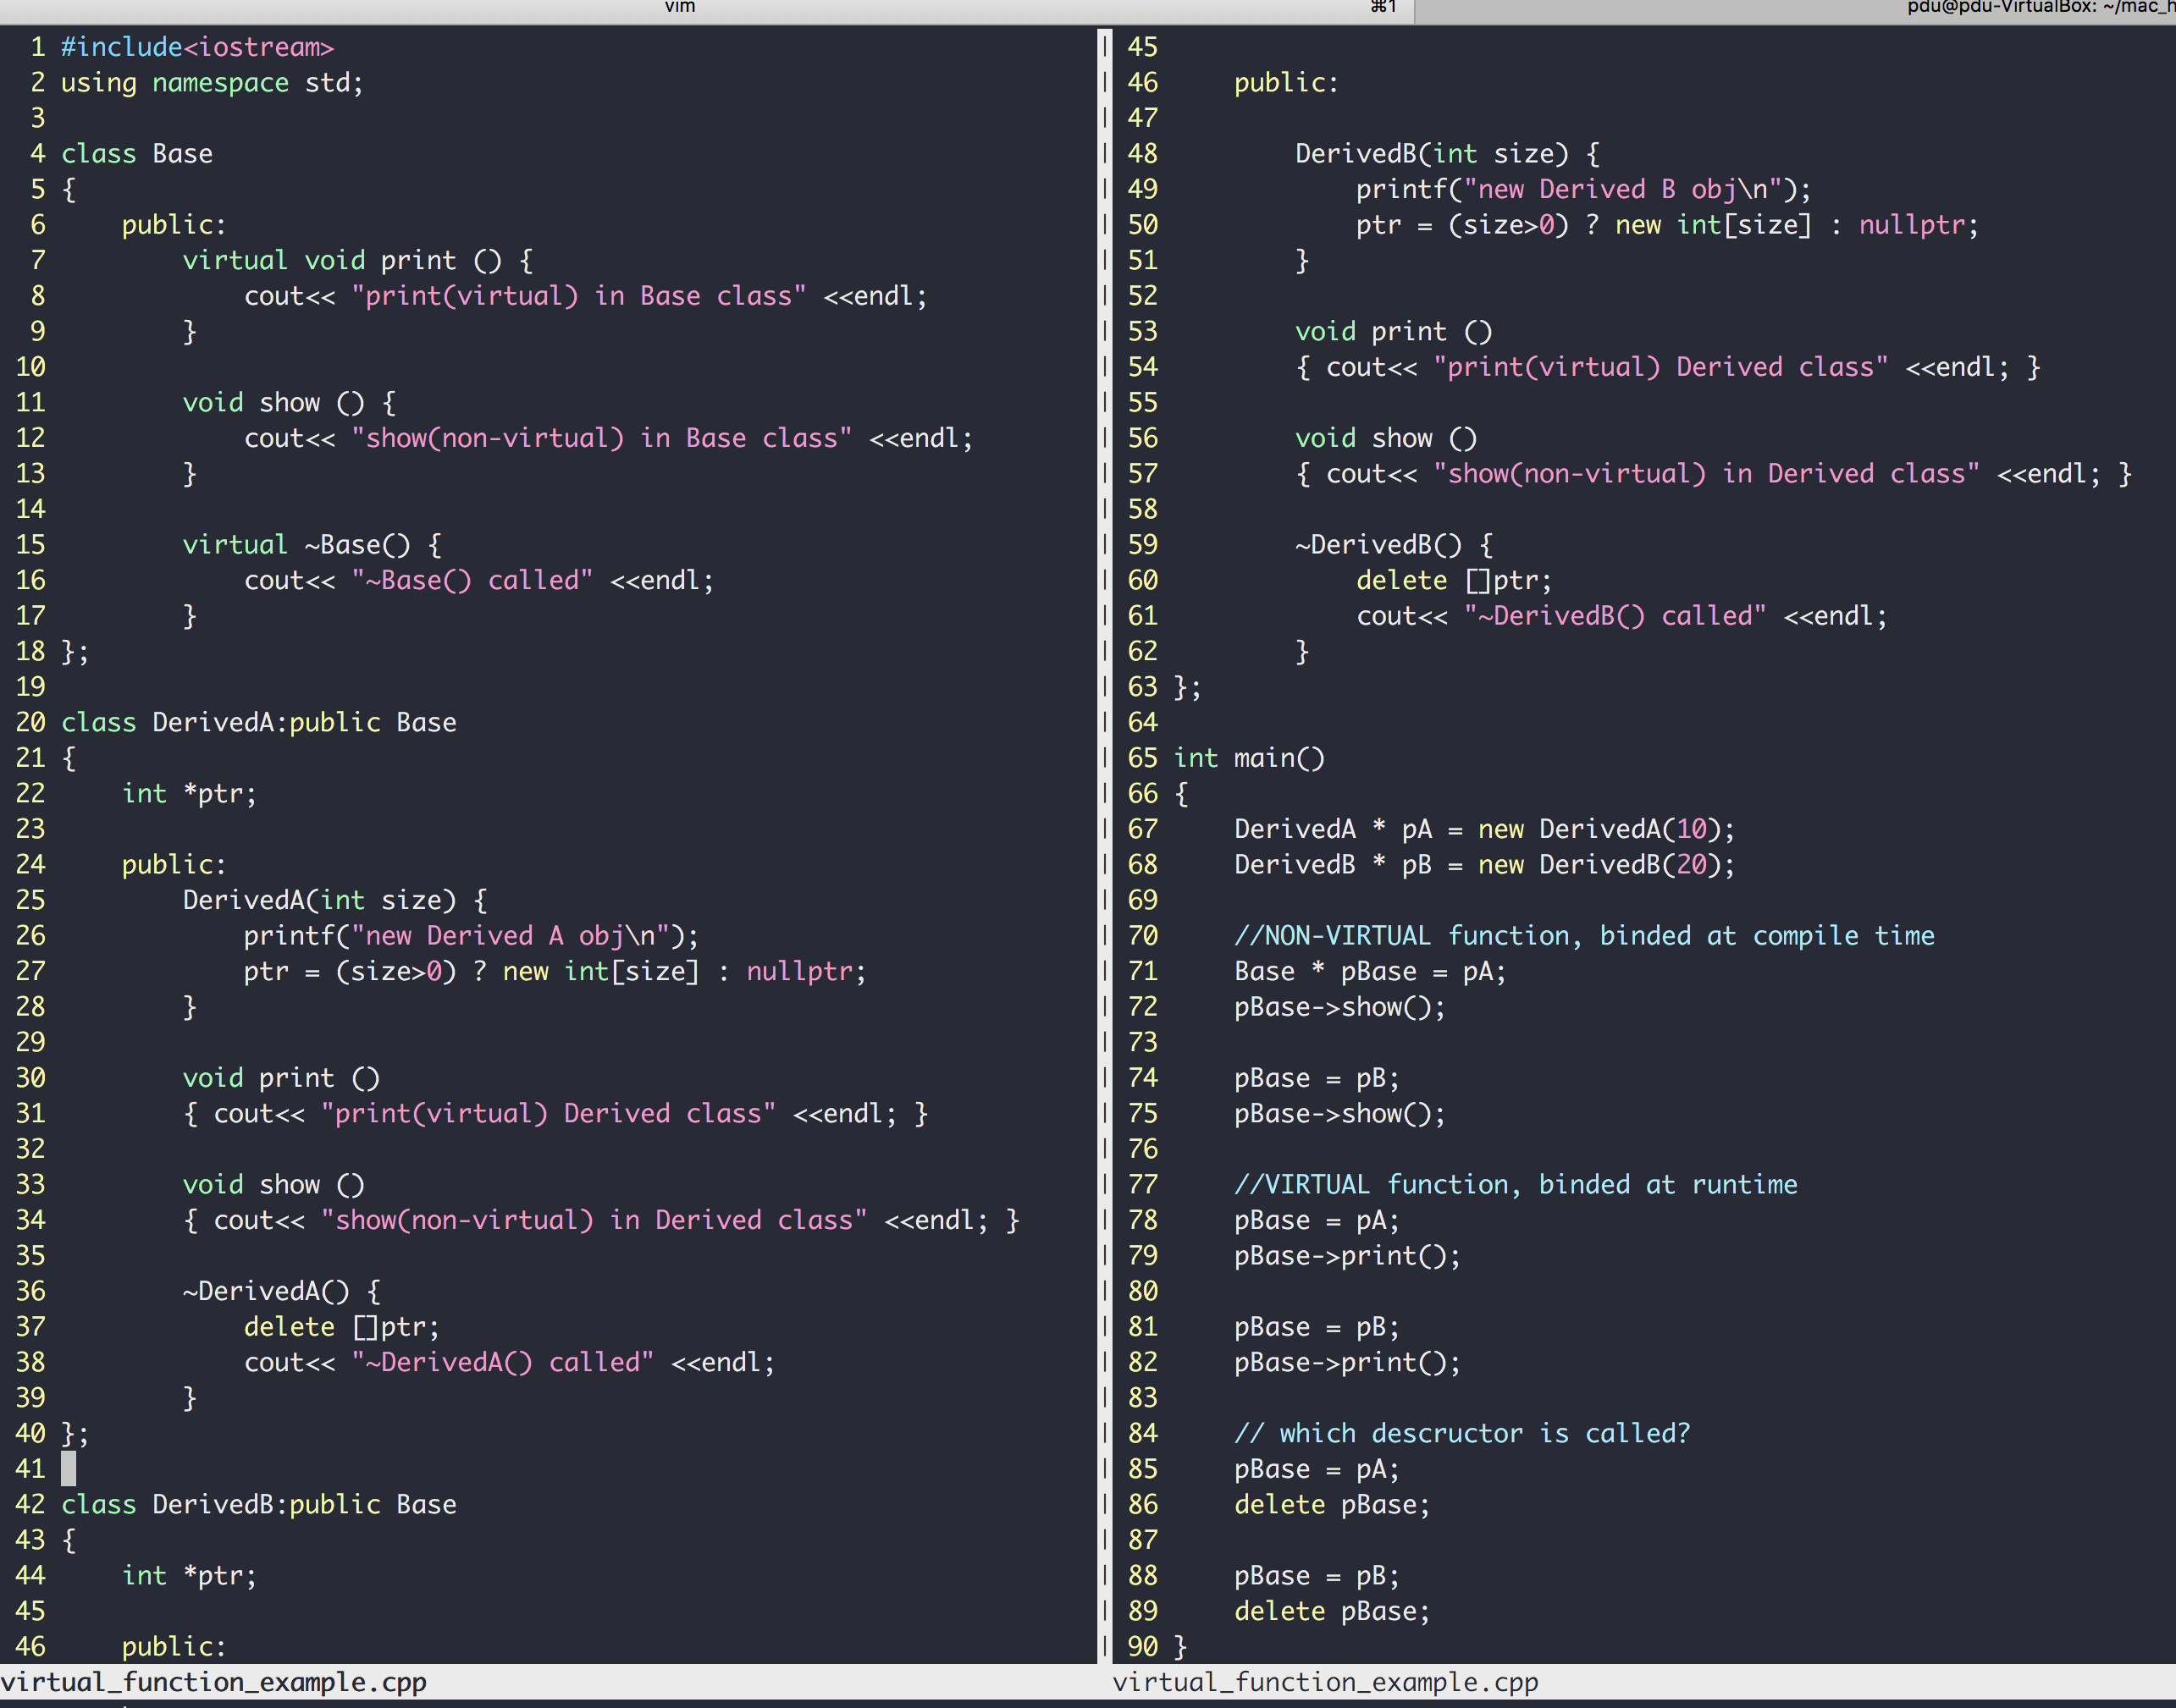
C++
“DerivedA class is a kind of Base class"
Class inheritance
Polymorphism
Virtual members
Pointers to base class
Invoke derived func
more example here
Same base pointer, different functions invoked (dynamic binding)

Slide 12
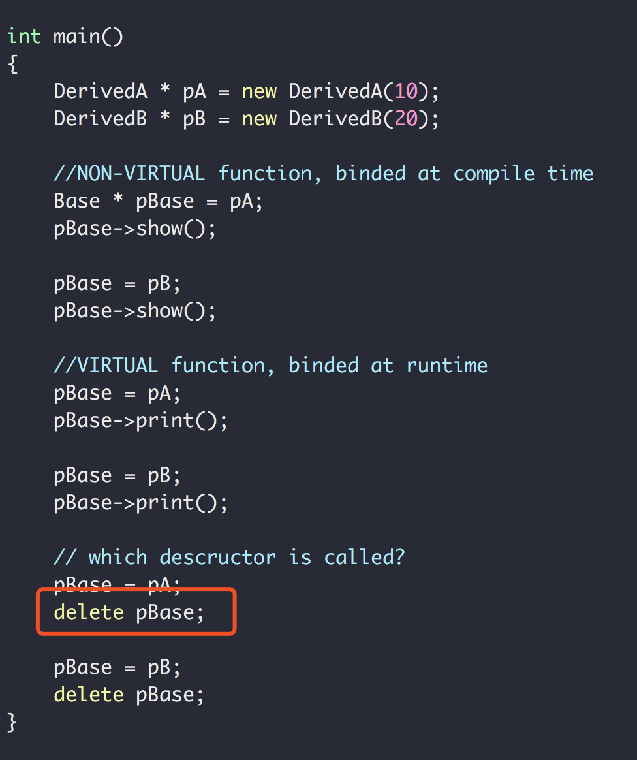
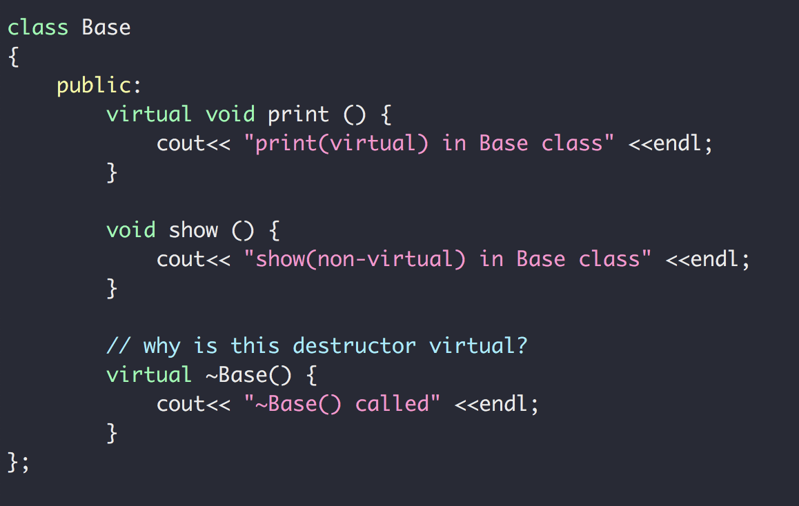
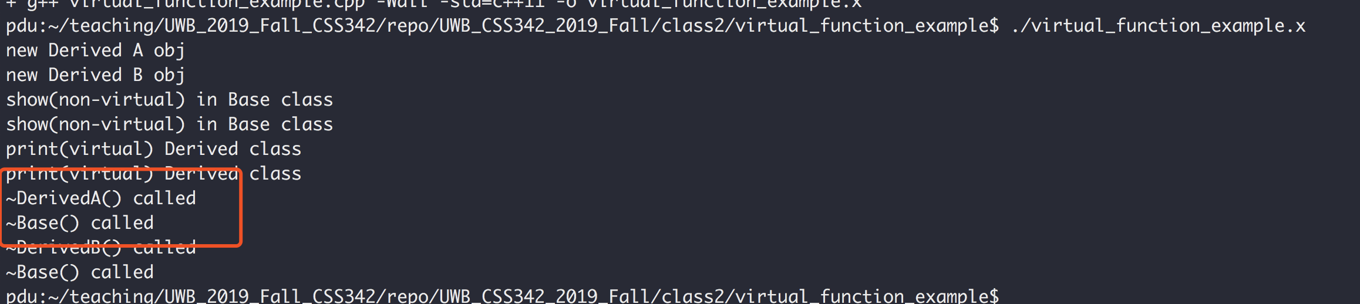
C++
So why the virtual destructor?
Also see https://www.youtube.com/watch?v=jELbKhGkEi0&t=56s

Slide 13
C++ Exercise
A card class
Has only one member function called area() that returns the area of the card
Write the class for card, square card and circular card
area() is implemented in the way of polymorphism
Unit is float
Square Card
Area = width x height
Circular Card
Area = pi x radius²
card
Area = ??

Slide 14
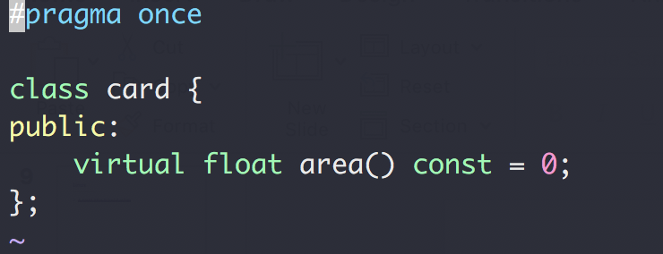
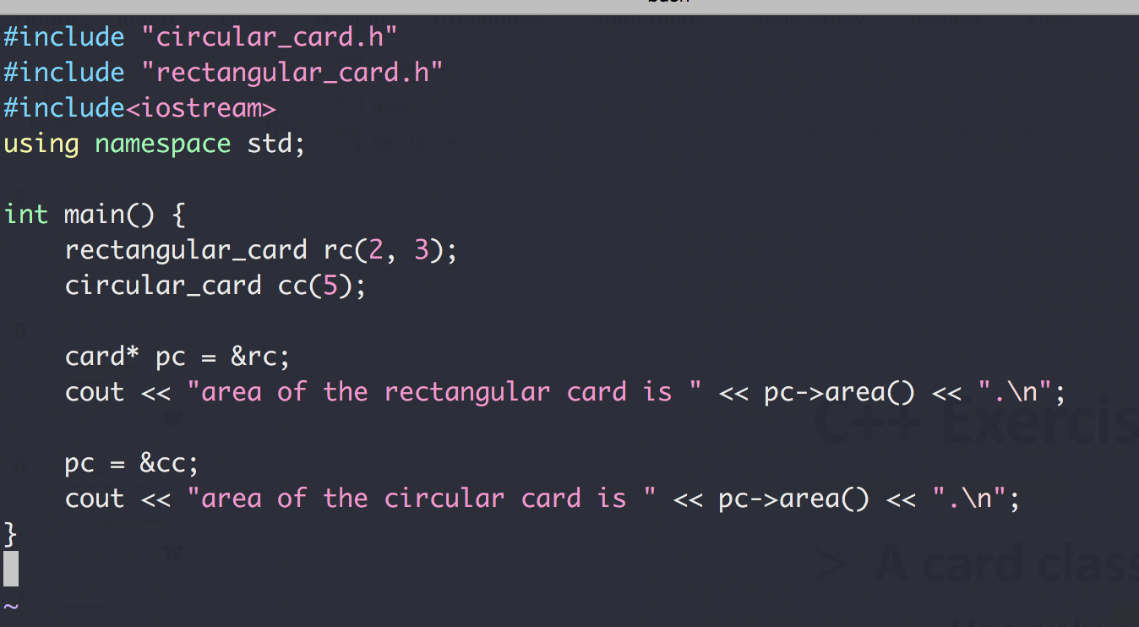
C++ Exercise

Slide 15
C++ Review
Template
A parameterized blueprint
Function Template (code: function_template)
Class Template (code: card_exercise/templated_version/)

Slide 16
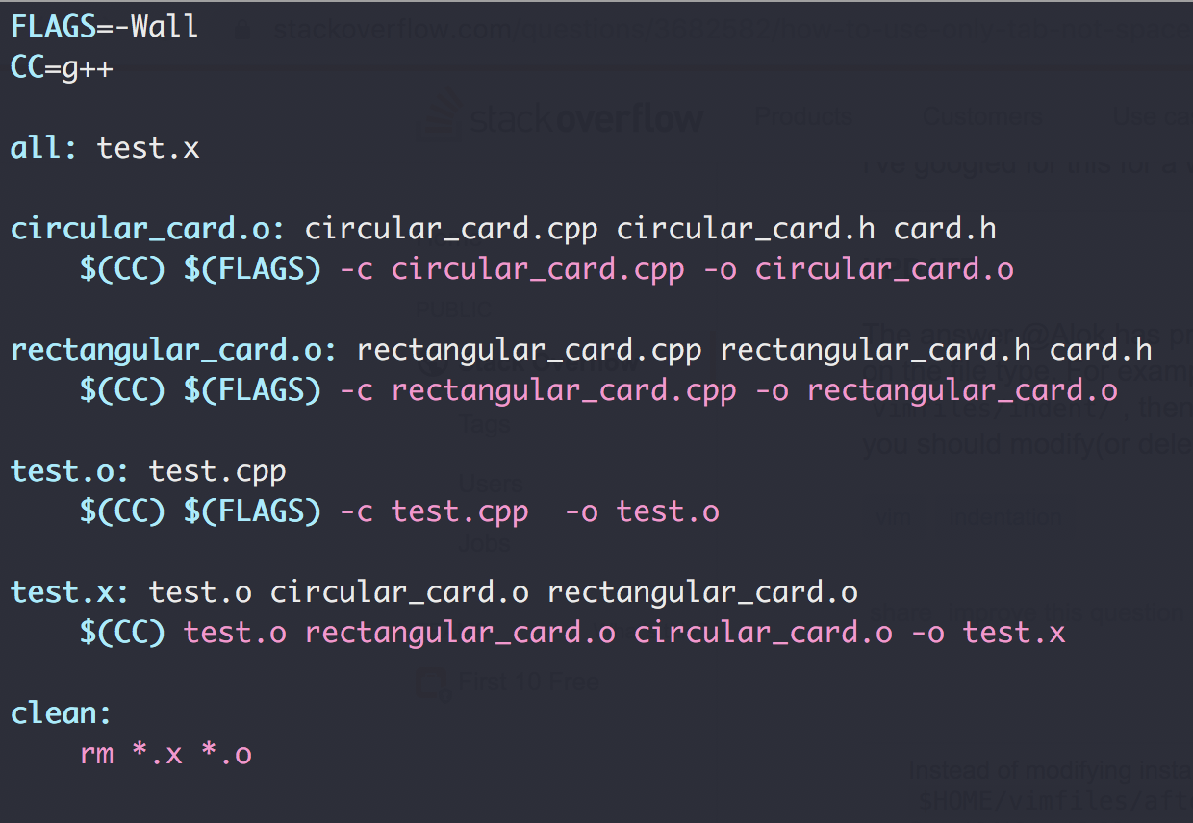
Makefile
goal
dependencies
actions

Slide 17
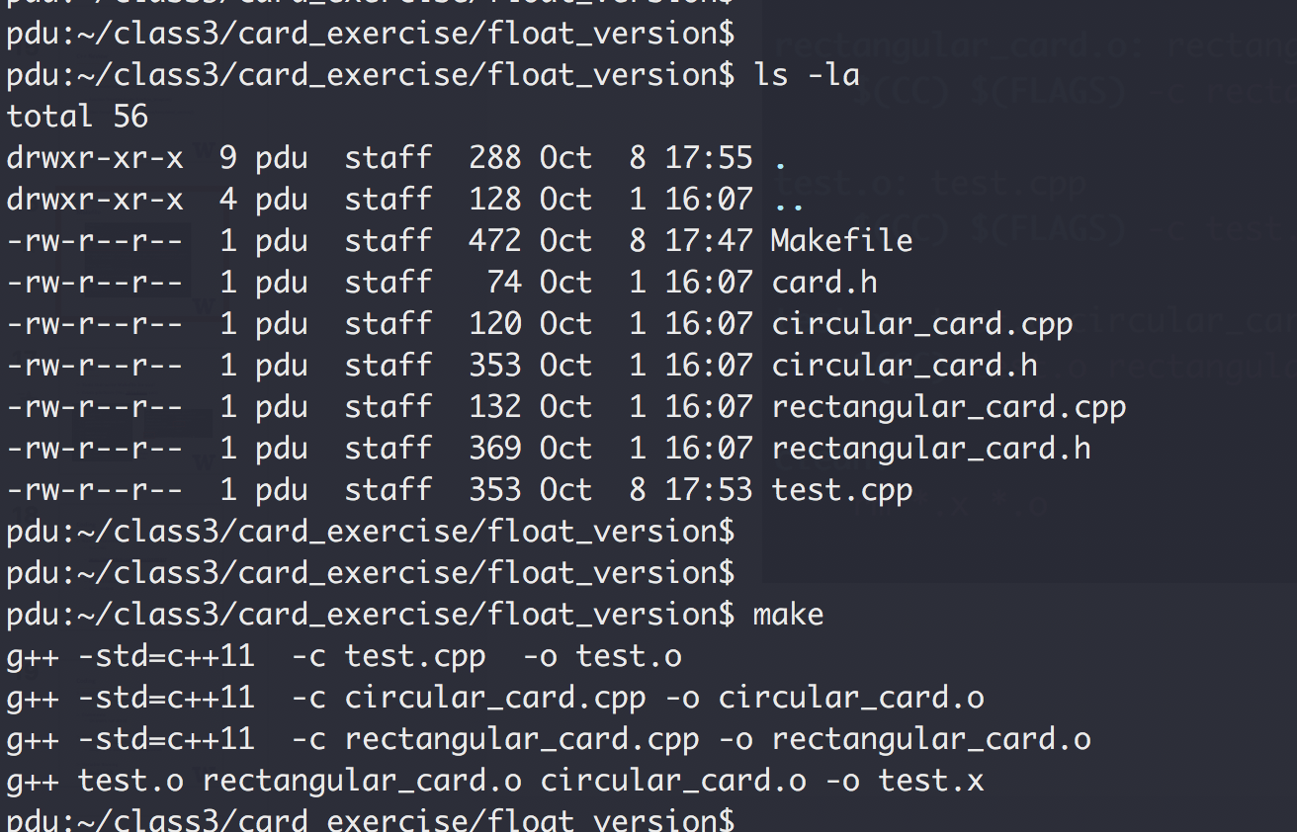
Makefile

Slide 18
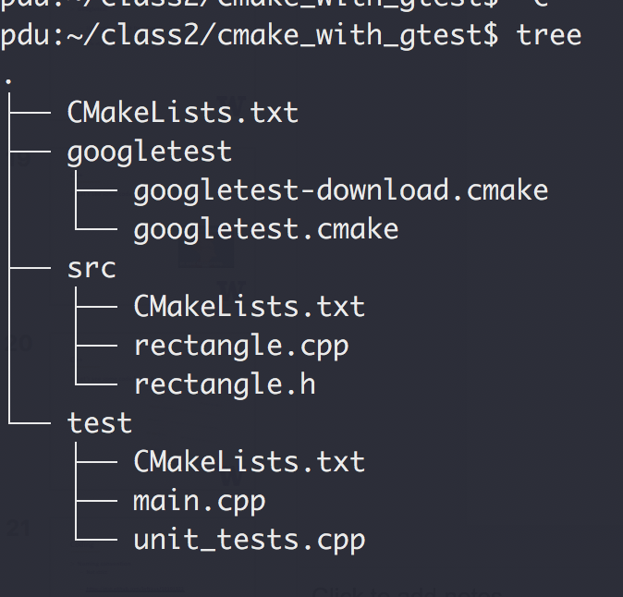
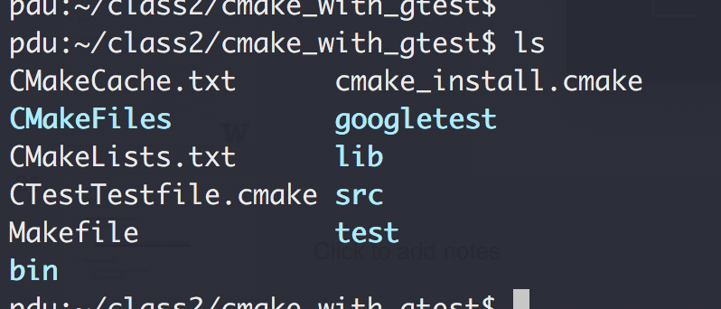
CMake
Tools that write Makefile for you!
Cross-platform (Yes, Windows too)
cmake .
make
A good CMake tutorial

Slide 19
Coding
Naming convention
Not strict
https://gist.github.com/lefticus/10191322
Bottomline:
Pick and follow a rule set
Be consistent

Slide 20
Coding
Avoid duplicates
No same logic more than once!
No same constants more than once
Comments
On intent, not action
Modular
Cohesion: 1 task per module
Coupling: As loosely coupled as possible
Variable Naming
Jacob’s guide

Slide 21
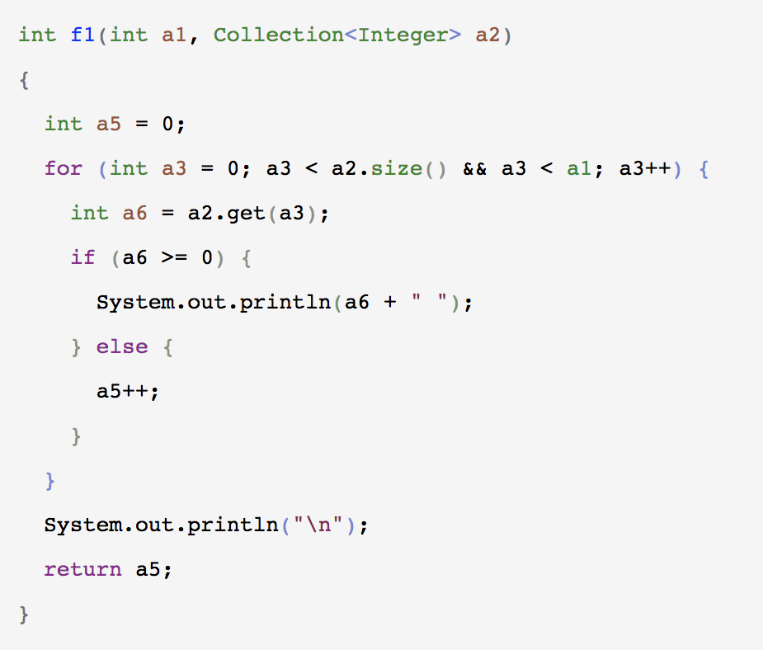
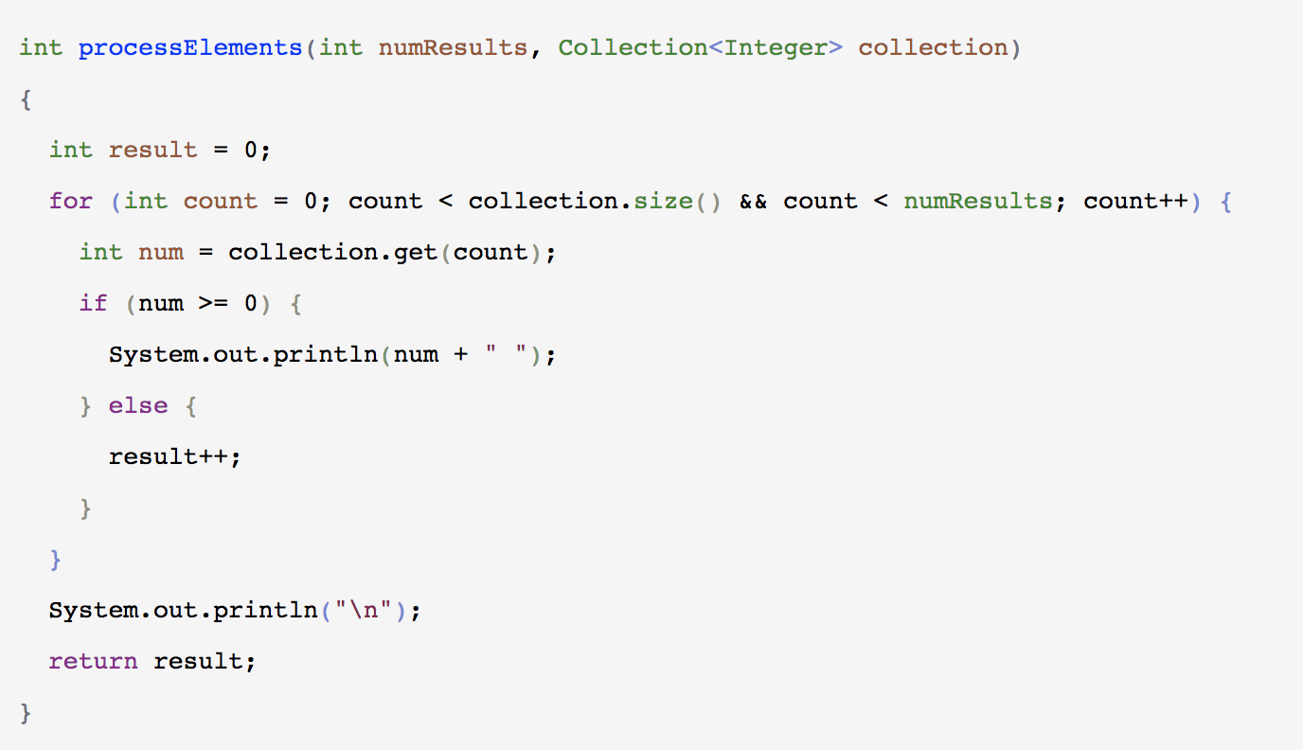
Coding
https://a-nickels-worth.blogspot.com/2016/04/a-guide-to-naming-variables.html

Slide 22
Coding
Testing
Unit tests:
individual units/ components of a software are tested
smallest testable unit
MyArray::Sort()
MyArray::Reverse()
MyArray::Swap
Integration tests
Test Driven Development
Video: “TDD, Where Did It All Go Wrong”

Slide 23
END OF C++ REVIEW

Slide 24
Object-Oriented Analysis And Design
What does “problem solving” mean?
Give a list of elements, implement the following function:
Add an element to the back of the list push_back(…)
Remove an element from the front of the list pop_front(…)
3
9
1
7
5
4
2
0
pushBack(…)
popFront(…)
4
2
0

Slide 25
Object-Oriented Analysis And Design
What does “problem solving” mean?
Give a list of elements, implement the following function:
Add an element to the back of the list push_back(…)
Remove an element from the front of the list pop_front(…)
10 mins, design and write the code
Use array in C++ to storage the data

Slide 26
Object-Oriented Analysis And Design
Let’s see some code

Slide 27
Object-Oriented Analysis And Design
What does “problem solving” mean?
Give a list of elements, implement the following function:
Add an element to the back of the list push_back(…)
Remove an element from the front of the list pop_front(…)
Procedural (aka steps)
Class Entity
array
Array
pushback()
popFront()
Member variables
PushBack()
Member functions
PopFront()
Test
Test()

Slide 28
Design Principals (“Specification” in C++ ch. 1.3)
Modular design
Split a problem into modules (e.g. classes)
Each modules states what it does
No module “know” how any other module works
Applies to
Single application (e.g. main, list, test)
Large scale Microservices (see how Uber does it)
And remember the class scheduling example?

Slide 29
Design Principals (“Specification” in C++ ch. 1.3)
https://medium.com/edureka/microservice-architecture-5e7f056b90f1

Slide 30
Design Principals (“Specification” in C++ ch. 1.3)
Operation Contracts
What methods are available to public
How a method can be used
Inputs
Outputs
Exception
What limitations
Example:
List in C++ Standard Template Library (STL)
Facebook’s /{object-id}/likes API

Slide 31
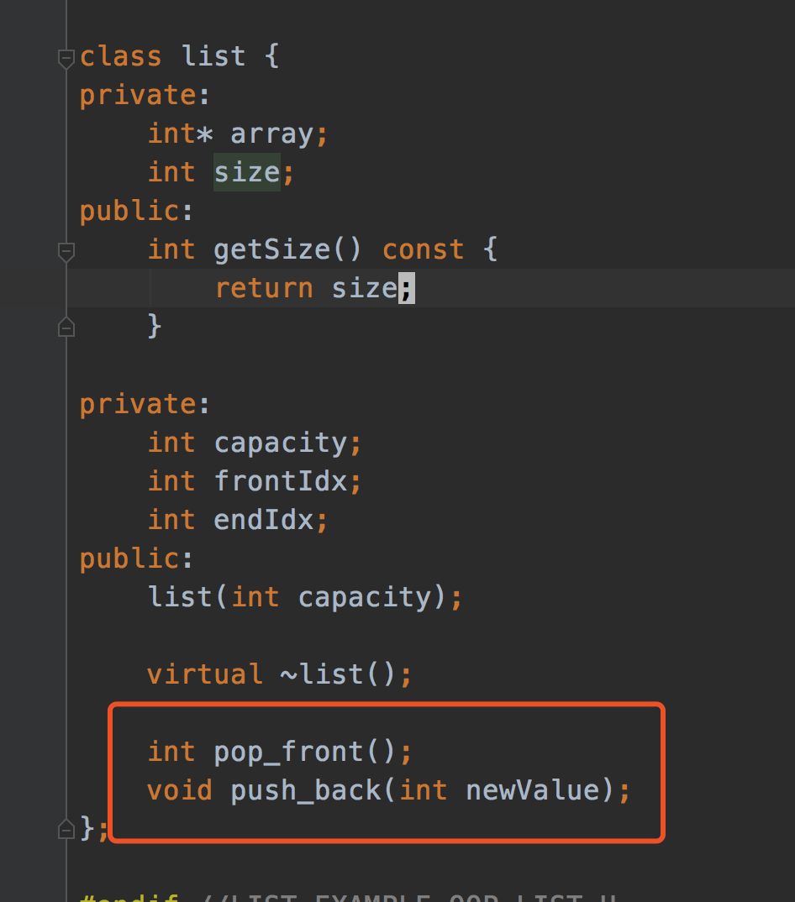
Design Principals (“Specification” in C++ ch. 1.3)
Unusual Conditions
Assume invalid situations never occur
Ignore the invalid situations
Guess (Assume) client’s intention
Return a value signaling a problem
Throw an exception
Error Hiding (swallowing)

Slide 32
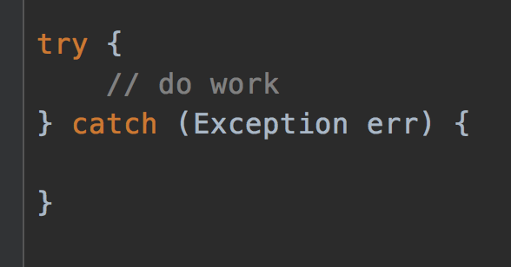
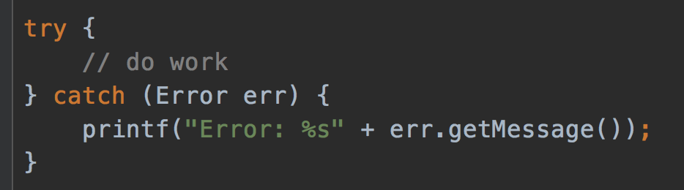
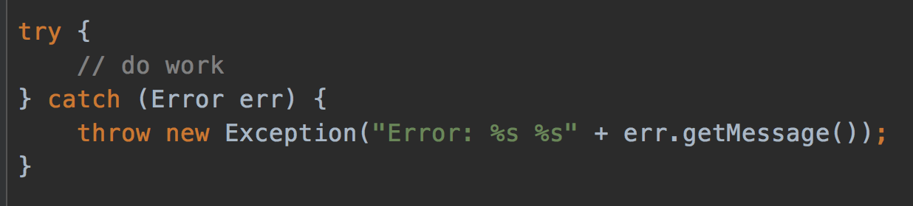
Error hiding
VERY BAD
STILL BAD
GOOD, but how to improve?
https://www.ibm.com/support/pages/best-practice-catching-and-re-throwing-java-exceptions

Slide 33
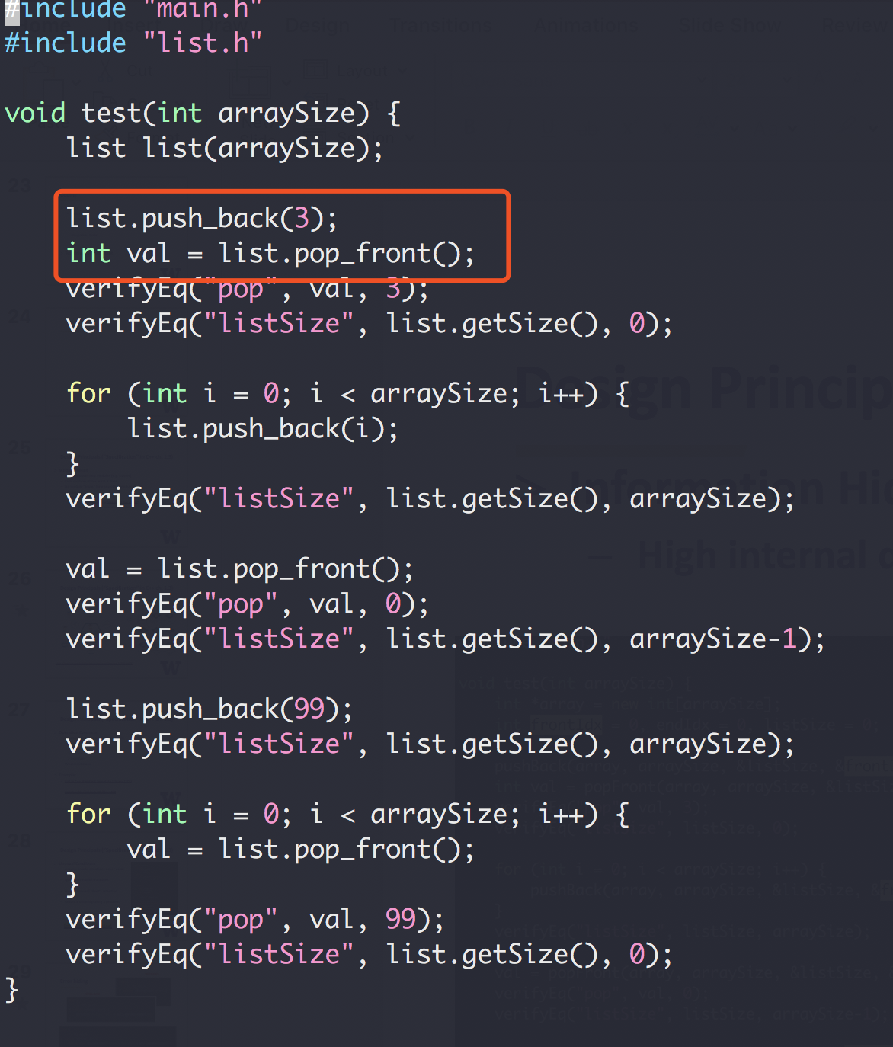
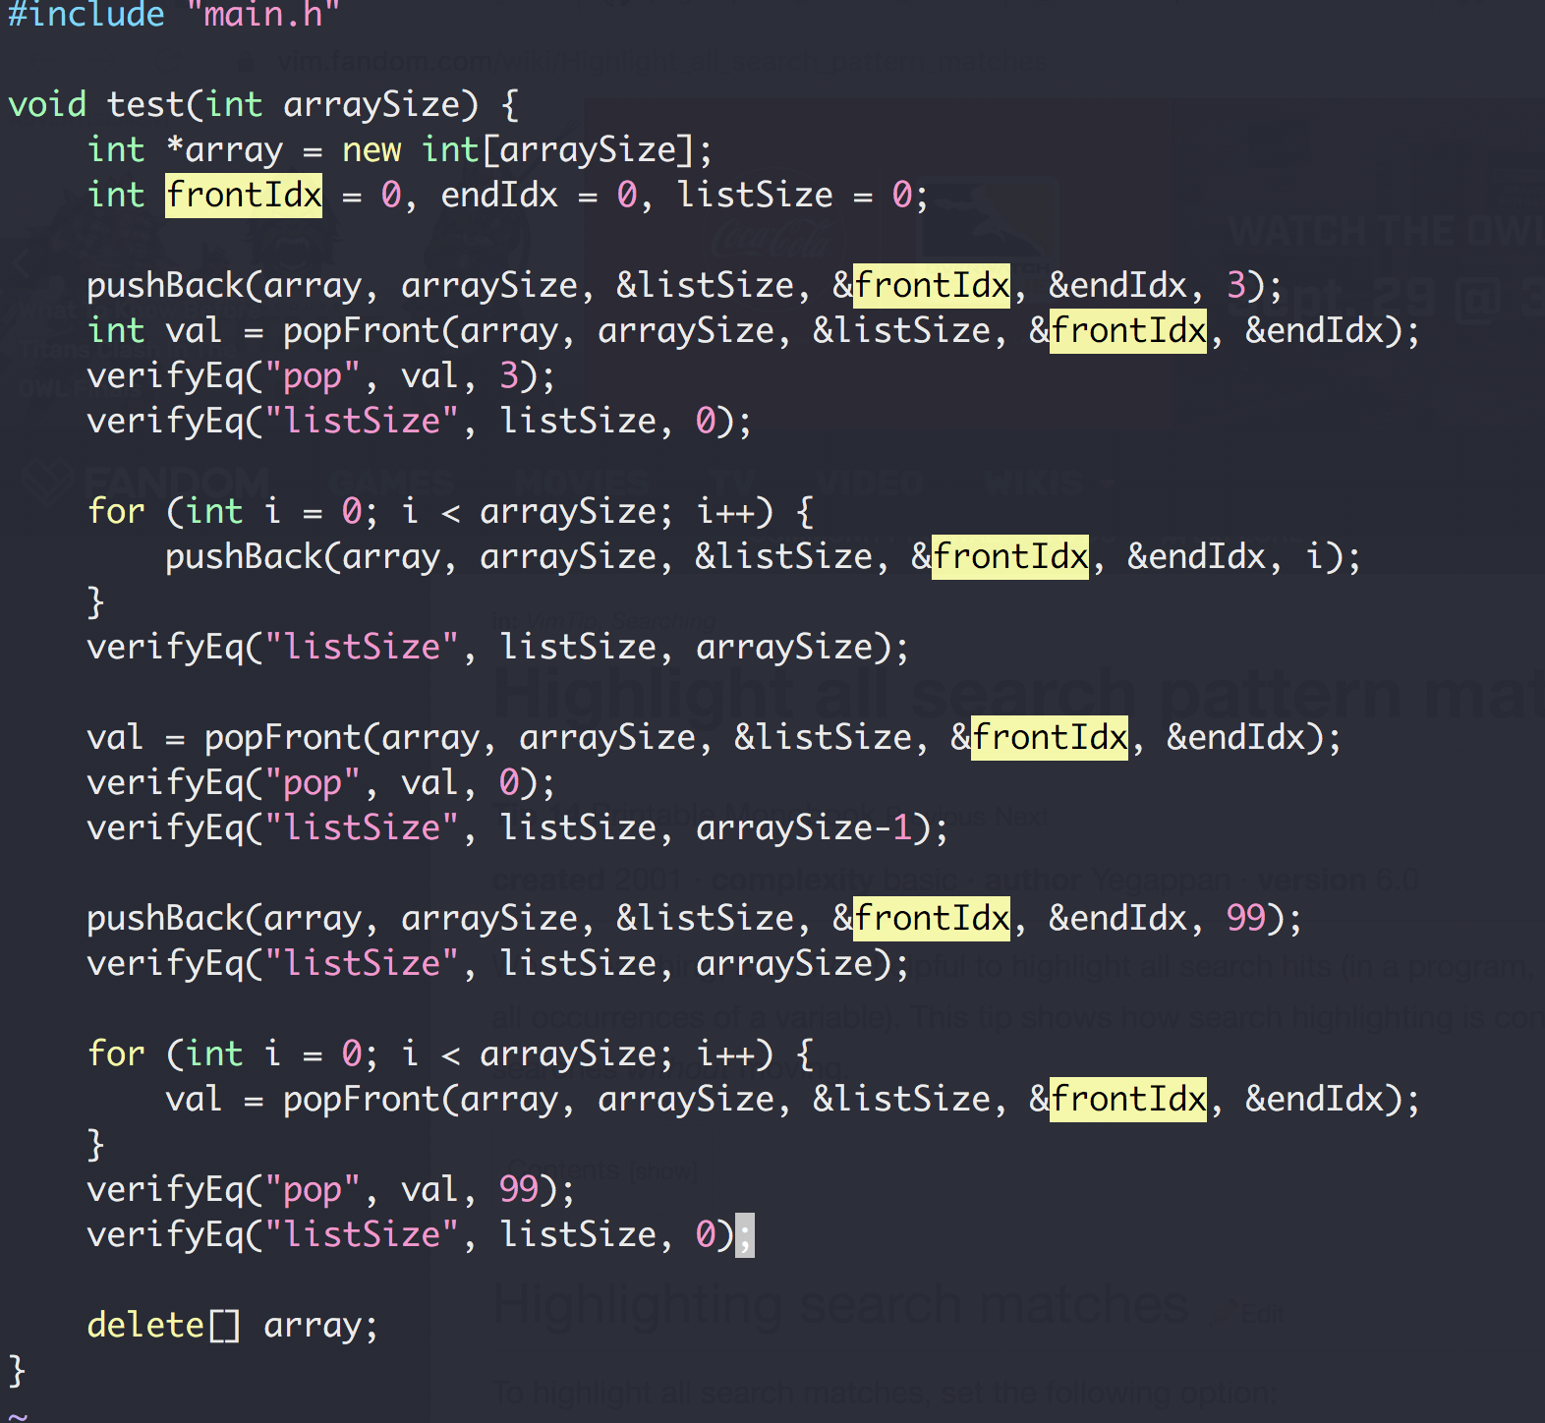
Design Principals (“Specification” in C++ ch. 1.3)
Information Hiding
High internal details from external clients

Slide 34
OOP Design
A bag of card of different shape cards
Exercise

